Slide 1
Northwest Campus Redevelopment
Phased Parking Lot Construction Plan

Slide 2
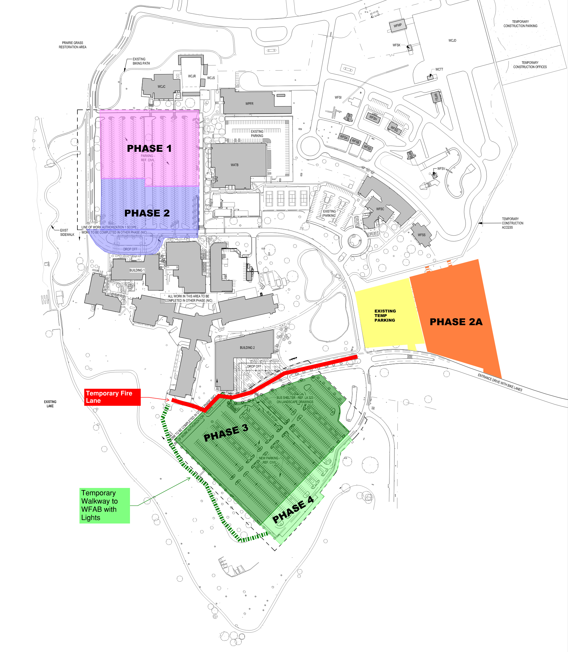
Overall Parking Plan
Phase 1
7/5/2022 to 7/15/2022
Phase 2
7/5/2022 to 9/9/2022
Phase 2A
8/15/2022 to 9/14/2022
Phase 3
9/19/2022 to 1/31/2023
Current Peak Parking Demand
North Lot | 791
South Lot | 401
WFSC | 98
WATB | 60
Temp Lot 2021 | 98
Total | 1448
Current Parking Spaces Available | 2036
Phase 4
2/1/2023 to 6/20/2023
Phased Landscaping
South Lot
2/1/2023 to 6/30/2023

Slide 3
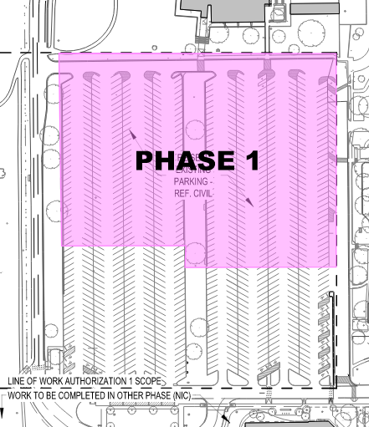
Phase 1 – North Lot – North Side
Work to begin 7/5/2022
Work will begin on the East side of the lot
Lot will be turned over as each section is completed
Resurfacing of fire lanes will take place on weekends
Fire lanes will be open to one way traffic during the week
Work to be complete by 7/15/2022
Phase 1 North Lot - North | ADA | Parking
North Lot | 0 | 0
South Lot | 30 | 580
Overflow | 0 | 225
WFSC | 4 | 94
WATB | 5 | 96
Temp Lot 2021 | 0 | 100
Temp Lot 2022 | 0 | 0
Total | 39 | 1095
Total Spaces Available |  | 1134
Available Parking During This Time

Slide 4
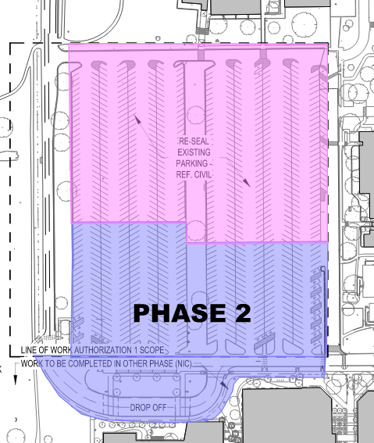
Phase 2 – North Lot – South Side
Work to begin 7/5/2022
This work will begin concurrently with the North Side of the lot
There will be major earthwork to bring the parking lot grade to the same level as Building 1, with slopes to the accessible parking
Work to be complete by 9/9/2022
Phase 2 North Lot - South | ADA | Parking
North Lot (After 7/15/22) | 6 | 501
South Lot | 30 | 580
Overflow | 0 | 225
WFSC | 4 | 94
WATB | 5 | 96
Temp Lot 2021 | 0 | 100
Temp Lot 2022 | 0 | 0
Total | 45 | 1596
Total Spaces Available |  | 1641
Available Parking During This Time

Slide 5
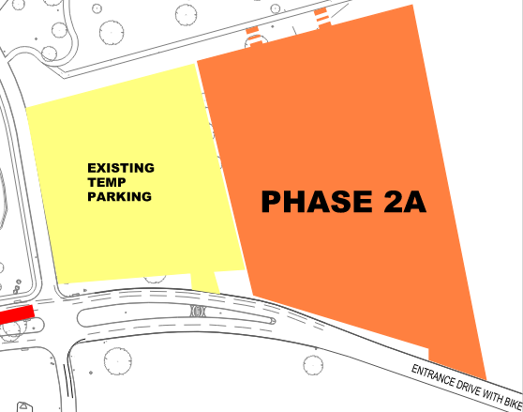
Phase 2A – Added Temporary Parking
Work to begin 8/15/2022
Additional 250 vehicle temporary parking
New curb cut along entrance drive for entry and exit
Temporary lighting will be installed
Walkways added to connect to existing sidewalk
Work to be complete by 9/14/2022
*Parking lot capacity remains the same as Phase 2 while this temporary lot is constructed

Slide 6
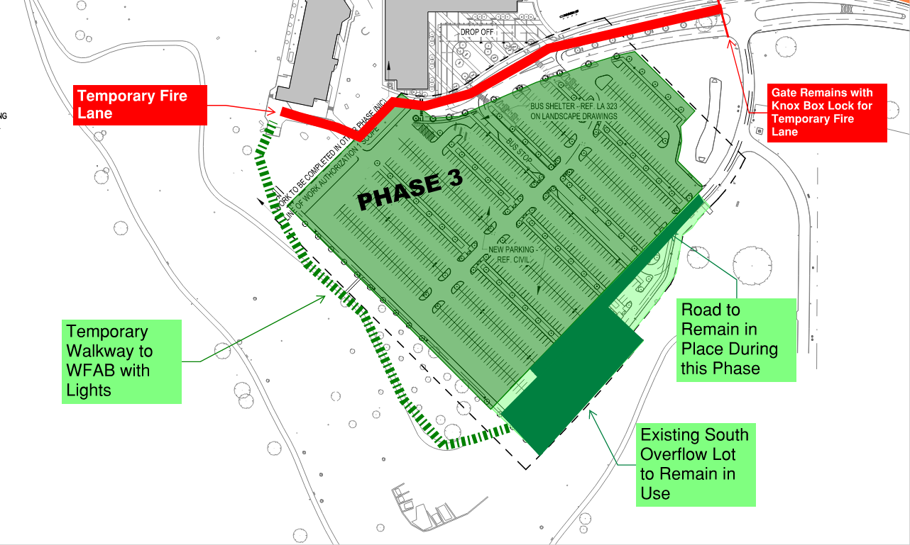
Phase 3 – South Lot
Work to begin 9/19/2022
Overflow parking at south end of the lot to remain in place for this phase of work
Temporary walkway to connect from Overflow lot to WFAB with lighting
Temporary fire lane will be in place for emergency vehicles only
Work to be complete by 1/31/2023
Phase 3 South Lot | ADA | Parking
North Lot | 24 | 835
South Lot | 0 | 0
Overflow | 0 | 80
WFSC | 4 | 94
WATB | 5 | 96
Temp Lot 2021 | 0 | 100
Temp Lot 2022 | 0 | 250
Total | 33 | 1455
Total Spaces Available |  | 1488
Available Parking During This Time

Slide 7
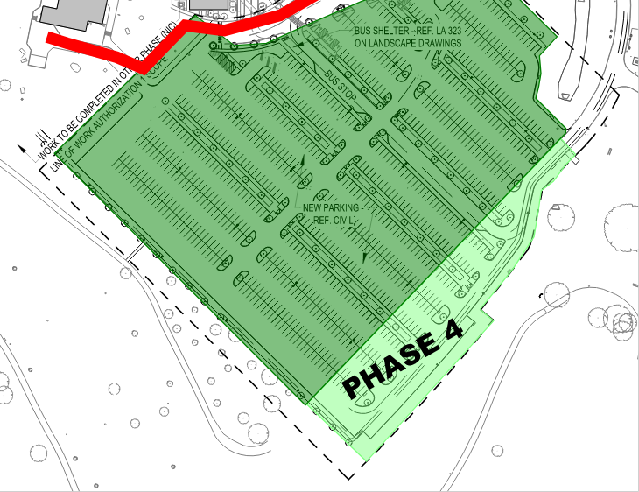
Phase 4 – South Overflow Lot
Work to begin 2/1/2023
This work will incorporate the existing overflow parking to the south into the lot
Landscaping work for the entire South lot will be completed during this time
Work to be complete by 6/20/2023
Phase 4 South Overflow Lot | ADA | Parking
North Lot | 24 | 835
South Lot | 21 | 841
Overflow | 0 | 0
WFSC | 4 | 94
WATB | 5 | 96
Temp Lot 2021 | 0 | 100
Temp Lot 2022 | 0 | 250
Total | 54 | 2216
Total Spaces Available |  | 2270
Available Parking During This Time

Slide 8
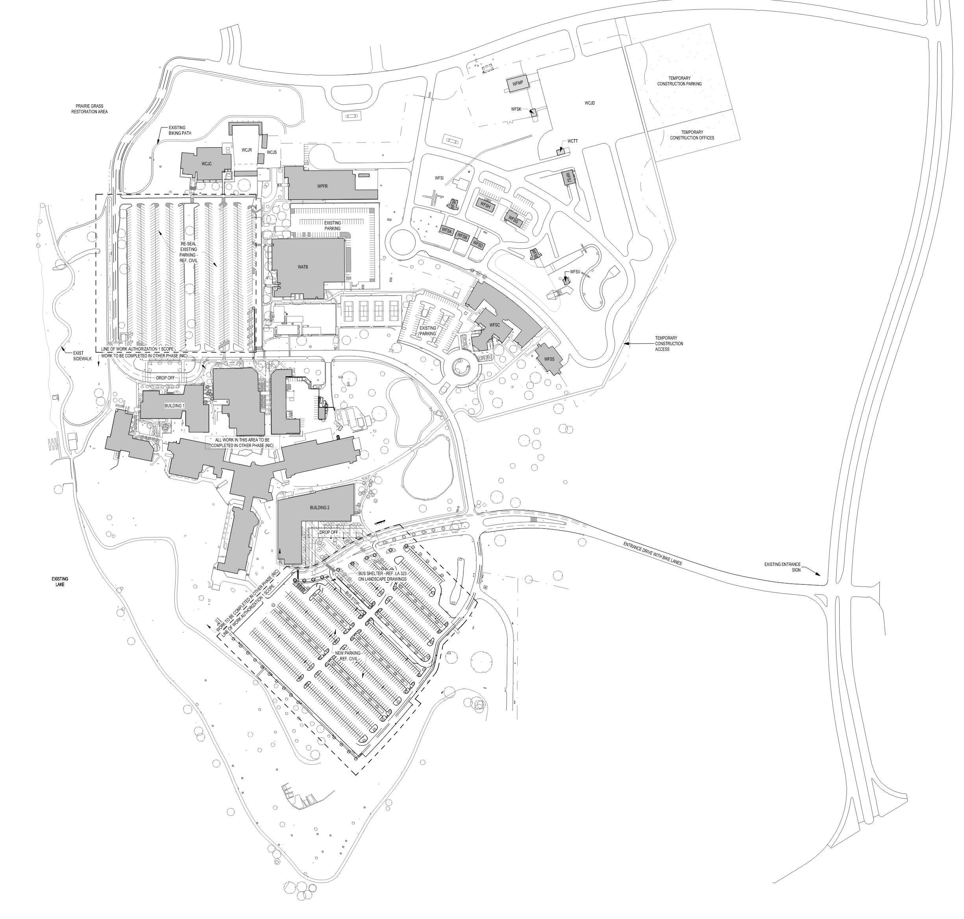
Parking Count at Completion
Temporary Lots will be removed when work is complete in 6/2023
All campus parking will be paved
Additional 11 spaces available at completion
At Completion | ADA | Parking
North Lot | 24 | 835
South Lot | 21 | 968
Overflow | 0 | 0
WFSC | 4 | 94
WATB | 5 | 96
Temp Lot 2021 | 0 | 0
Temp Lot 2022 | 0 | 0
Total | 54 | 1993
Total Spaces Available |  | 2047

Slide 9
Thank You!

